Slide 1
GUI with JavaFX

Slide 2

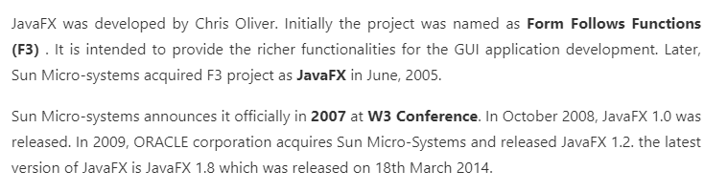

JavaFX is a Java library used to develop Desktop applications as well as Rich Internet Applications (RIA). The applications built in JavaFX, can run on multiple platforms including Web, Mobile and Desktops.
JavaFX is intended to replace swing in Java applications as a GUI framework. However, It provides more functionalities than swing. Like Swing, JavaFX also provides its own components and doesn't depend upon the operating system. It is lightweight and hardware accelerated. It supports various operating systems including Windows, Linux and Mac OS.

Slide 3

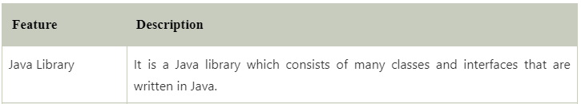

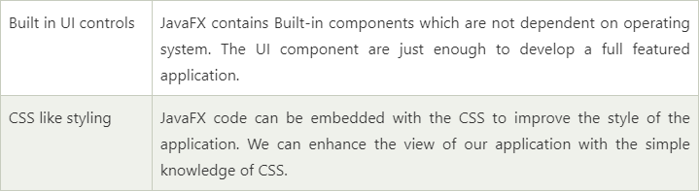


Slide 4
JavaFX vs Swing: The Key Differences
The main differences between the two tools come down to flexibility, power, and popularity. Swing still sees lots of use in GUI creation, both because of its ease of use and its widespread employment across the industry. Creating complex interfaces is a breeze with either approach, though. Desktop applications come together more easily when you use FX, and the younger tool gains ground on its big sibling every year.
Swing has a wider range of UI components compared to FX, but FX adds more all the time, so this difference might not be notable much longer. Likewise, JavaFX offers IDE support, but Swing’s IDE support is more mature and has more options for rapid deployment needs. On the flipside, FX offers consistent support for MVC, while Swing’s MVC support is not equal across all platforms.
In short, Swing and JavaFX are both GUI toolkits for Java programs. Swing is the old standard toolkit that features a bigger library of GUI elements and mature IDE support. JavaFX is the newer standard with a smaller library, more consistent updates, and consistent MVC support.
Which One is Right for You?
If you want a crackerjack GUI builder that gives you plenty of options during creation, or perhaps you want access to plenty of libraries as you work? Java Swing is likely going to be your cup of tea.
Web developers and folks who want to use the latest and greatest gear will find JavaFX to be right up their alley. FX adds modern touches to your project and makes adding animation and special effects a snap. FX is also the choice for folks who develop mobile apps—it is much more geared to work with mobile programs than Swing. And, FX is more streamlined across the board than the older tool. It’s a perfect option for developers with efficiency in mind.

Slide 5
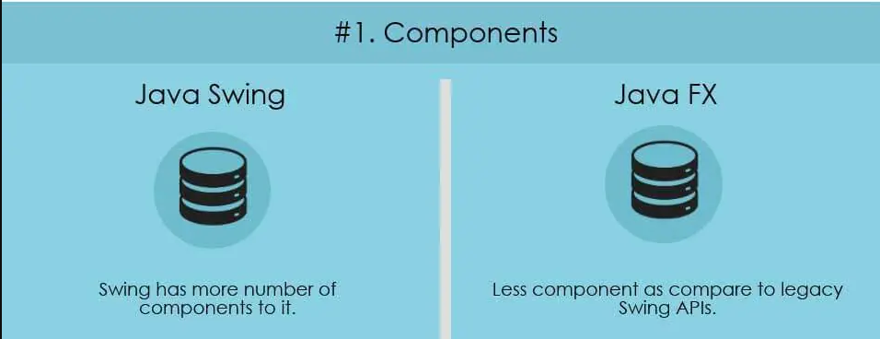
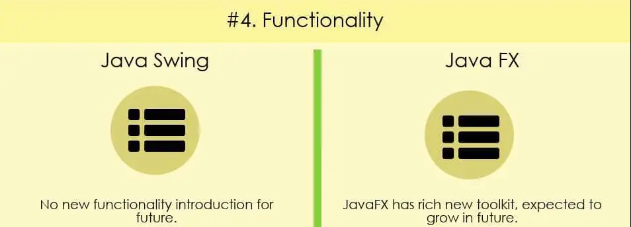
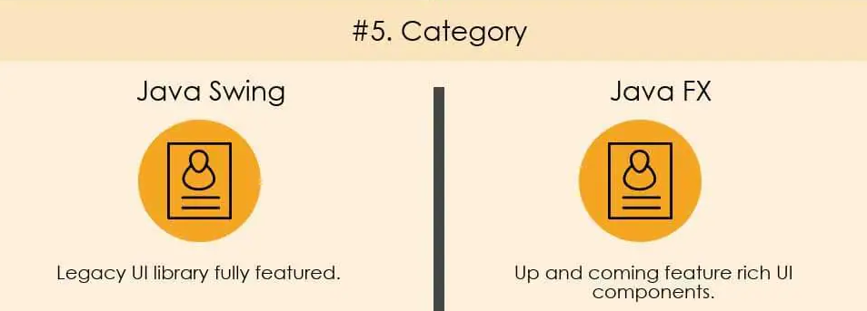
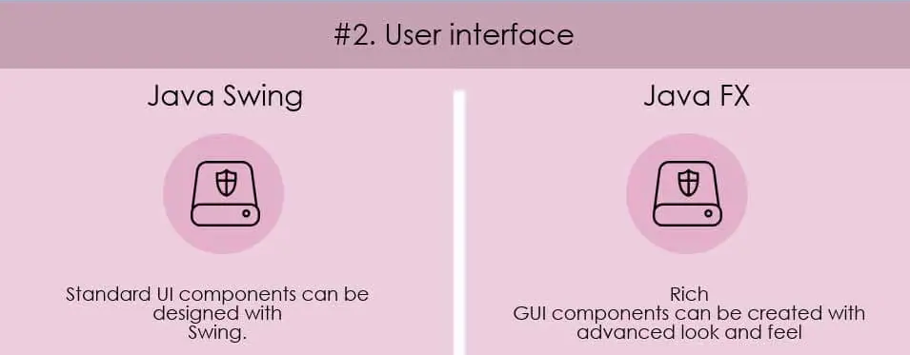

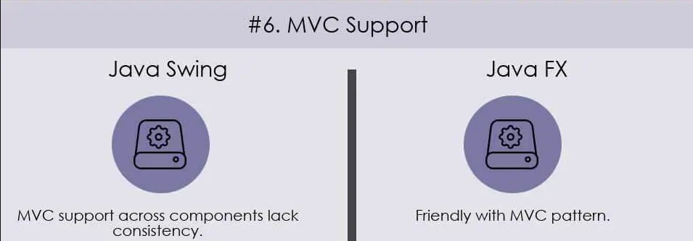
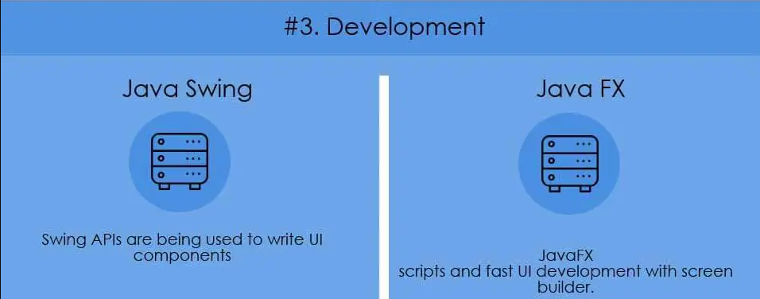
In short, Swing and JavaFX are both GUI toolkits for Java programs. Swing is the old standard toolkit that features a bigger library of GUI elements and mature IDE support. JavaFX is the newer standard with a smaller library, more consistent updates, and consistent MVC support.

Slide 6
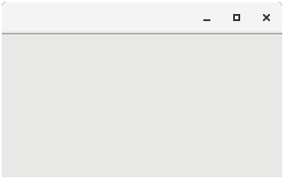
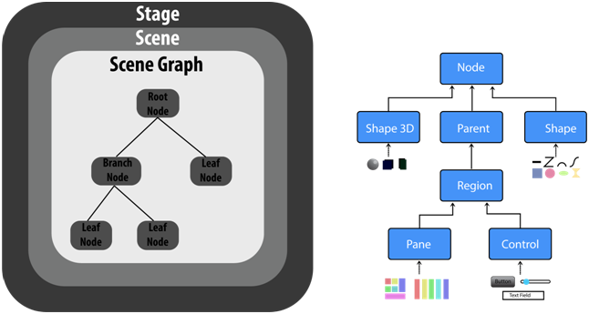
JavaFX Application Structure
JavaFX application is divided hierarchically into three main components known as Stage, Scene and nodes. We need to import javafx.application.Application class in every JavaFX application. This provides the following life cycle methods for JavaFX application.
public void init()
public abstract void start(Stage primaryStage)
public void stop()
in order to create a basic JavaFX application, we need to:
Import javafx.application.Application into our code.
Inherit Application into our class.
Override start() method of Application class.
Stage
Stage in a JavaFX application is similar to the Frame in a Swing Application. It acts like a container for all the JavaFX objects. Primary Stage is created internally by the platform. Other stages can further be created by the application. The object of primary stage is passed to start method. We need to call show method on the primary stage object in order to show our primary stage.
Scene
Scene actually holds all the physical contents (nodes) of a JavaFX application. Javafx.scene.Scene class provides all the methods to deal with a scene object. Creating scene is necessary in order to visualize the contents on the stage.

Slide 7
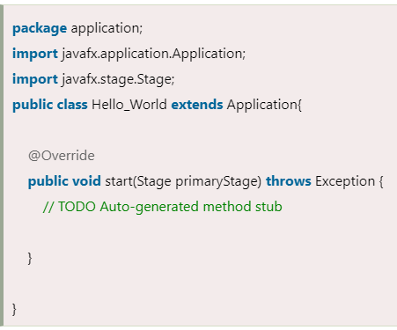
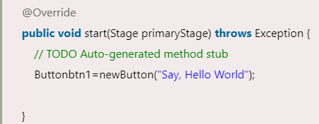
Creating Our first JavaFX Application
Step 1: Extend javafx.application.Application and override start()
start() method is the starting point of constructing a JavaFX application therefore we need to first override start method of javafx.application.Application class. Object of the class javafx.stage.Stage is passed into the start() method therefore import this class and pass its object into start method. JavaFX.application.Application needs to be imported in order to override start method.
Step 2: Create a Button
A button can be created by instantiating the javafx.scene.control.Button class. For this, we have to import this class into our code. Pass the button label text in Button class constructor.

Slide 8
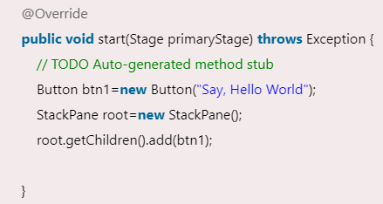
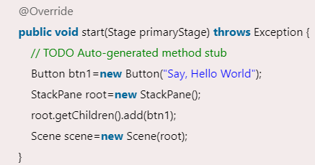
Step 3: Create a layout and add button to it
JavaFX provides the number of layouts. We need to implement one of them in order to visualize the widgets properly. It exists at the top level of the scene graph and can be seen as a root node. All the other nodes (buttons, texts, etc.) need to be added to this layout.
In this application, we have implemented StackPane layout. It can be implemented by instantiating javafx.scene.layout.StackPane class.
Step 4: Create a Scene
The layout needs to be added to a scene. Scene remains at the higher level in the hierarchy of application structure. It can be created by instantiating javafx.scene.Scene class. We need to pass the layout object to the scene class constructor.

Slide 9
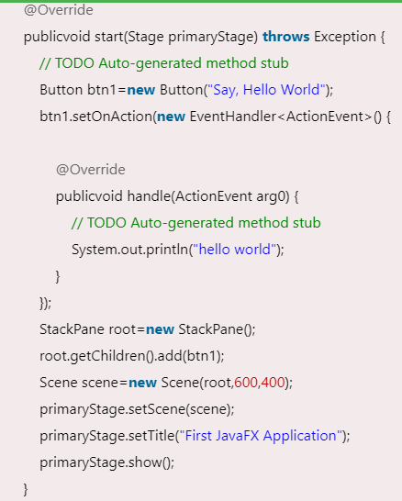
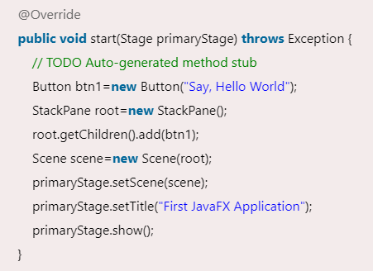
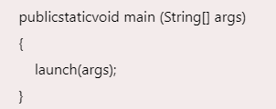
Step 6: Create an event for the button
Step 5: Prepare the Stage
As our application prints hello world for an event on the button. We need to create an event for the button. For this purpose, call setOnAction() on the button and define a anonymous class Event Handler as a parameter to the method.
Inside this anonymous class, define a method handle() which contains the code for how the event is handled.
javafx.stage.Stage class provides some important methods which are required to be called to set some attributes for the stage. We can set the title of the stage. We also need to call show() method without which, the stage won't be shown.
Step 7: Create the main method
Till now, we have configured all the necessary things which are required to develop a basic JavaFX application but this application is still incomplete. We have not created main method yet. Hence, at the last, we need to create a main method in which we will launch the application i.e. will call launch() method and pass the command line arguments (args) to it.

Slide 10
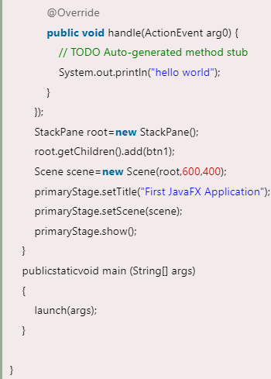
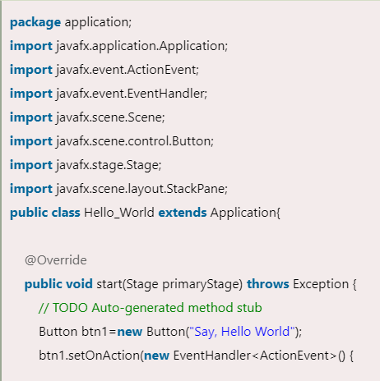
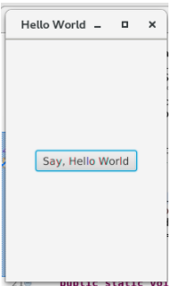

Slide 11
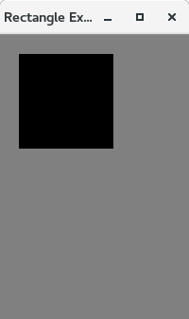
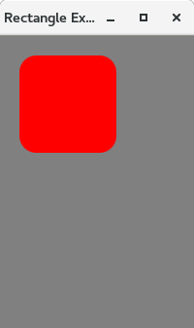
JavaFX Rectangle
public class Shape_Example extends Application{
@Override
public void start(Stage primaryStage) throws Exception {
// TODO Auto-generated method stub
primaryStage.setTitle("Rectangle Example");
Group group = new Group(); //creating Group
Rectangle rect=new Rectangle(); //instantiating Rectangle
rect.setX(20); //setting the X coordinate of upper left //corner of rectangle
rect.setY(20); //setting the Y coordinate of upper left //corner of rectangle
rect.setWidth(100); //setting the width of rectangle
rect.setHeight(100); // setting the height of rectangle
group.getChildren().addAll(rect); //adding rectangle to the //group
Scene scene = new Scene(group,200,300,Color.GRAY);
primaryStage.setScene(scene);
primaryStage.show();
}
public static void main(String[] args) {
launch(args);
}
}
Classwork:
package application;
import javafx.application.Application;
import javafx.scene.Group;
import javafx.scene.Scene;
import javafx.scene.paint.Color;
import javafx.scene.shape.Rectangle;
import javafx.stage.Stage;

Slide 12
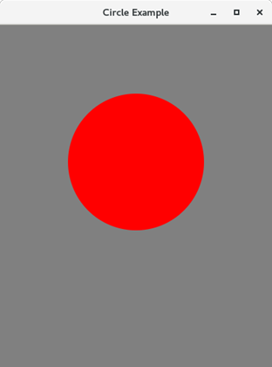
package application;
import javafx.application.Application;
import javafx.scene.Group;
import javafx.scene.Scene;
import javafx.scene.paint.Color;
import javafx.scene.shape.Circle;
import javafx.stage.Stage;
public class Shape_Example extends Application{
@Override
public void start(Stage primaryStage) throws Exception {
// TODO Auto-generated method stub
primaryStage.setTitle("Circle Example");
Group group = new Group();
Circle circle = new Circle();
circle.setCenterX(200);
circle.setCenterY(200);
circle.setRadius(100);
circle.setFill(Color.RED);
group.getChildren().addAll(circle);
Scene scene = new Scene(group,400,500,Color.GRAY);
primaryStage.setScene(scene);
primaryStage.show();
}
public static void main(String[] args) {
launch(args);
}
}
JavaFX Cirlce
A circle is a special type of ellipse with both of the focal points at the same position. Its horizontal radius is equal to its vertical radius. JavaFX allows us to create Circle on the GUI of any application by just instantiating javafx.scene.shape.Circle class. Just set the class properties by using the instance setter methods and add the class object to the Group.

Slide 13
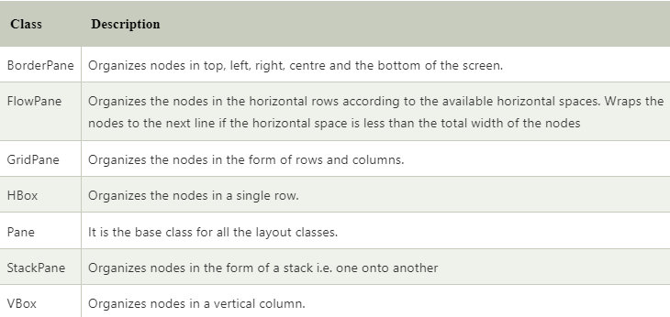
JavaFX Layouts
Layouts are the top level container classes that define the UI styles for scene graph objects. Layout can be seen as the parent node to all the other nodes. JavaFX provides various layout panes that support different styles of layouts.
All these classes belong to javafx.scene.layout package. javafx.scene.layout.Pane class is the base class for all the built-in layout classes in JavaFX.
Layout Classes

Slide 14
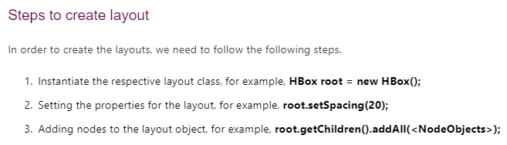
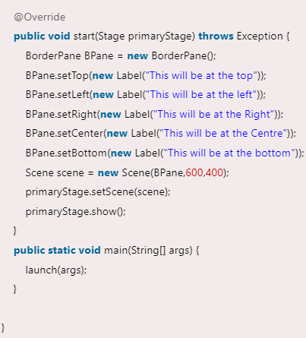
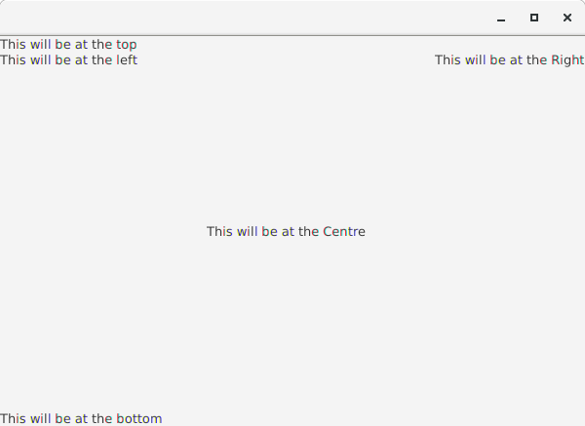
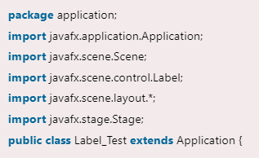
JavaFX BorderPane
BorderPane arranges the nodes at the left, right, centre, top and bottom of the screen. It is represented by javafx.scene.layout.BorderPane class. This class provides various methods like setRight(), setLeft(), setCenter(), setBottom() and setTop() which are used to set the position for the specified nodes. We need to instantiate BorderPane class to create the BorderPane layout.

Slide 15
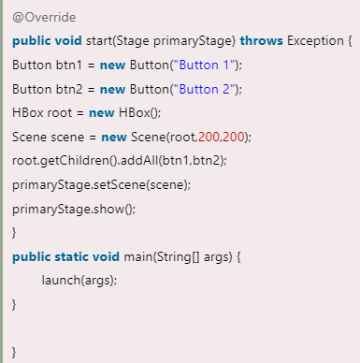
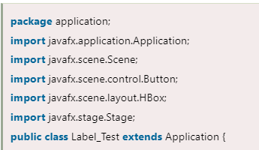
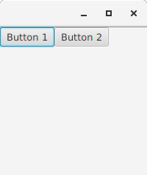
JavaFX HBox
HBox layout pane arranges the nodes in a single row. It is represented by javafx.scene.layout.HBox class. We just need to instantiate HBox class in order to create HBox layout.

Slide 16
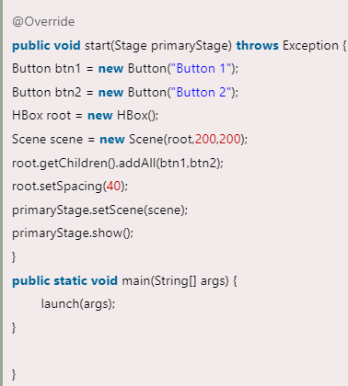
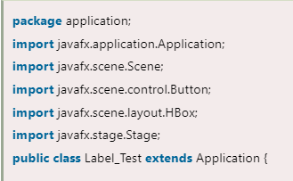
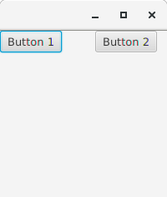
Example : Setting the space among the nodes.

Slide 17
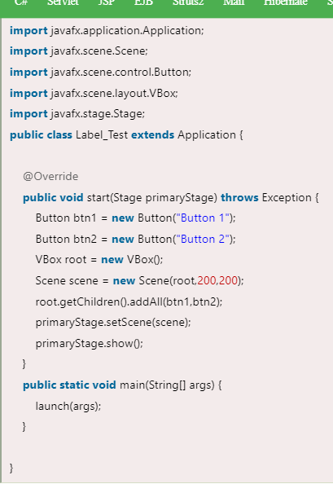
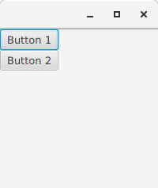
JavaFX VBox
Instead of arranging the nodes in horizontal row, Vbox Layout Pane arranges the nodes in a single vertical column. It is represented by javafx.scene.layout.VBox class which provides all the methods to deal with the styling and the distance among the nodes. This class needs to be instantiated in order to implement VBox layout in our application.

Slide 18
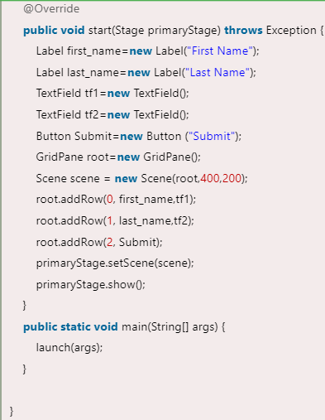
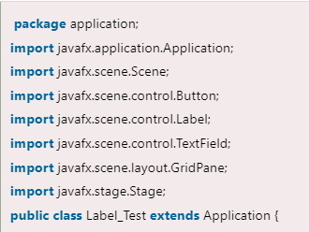
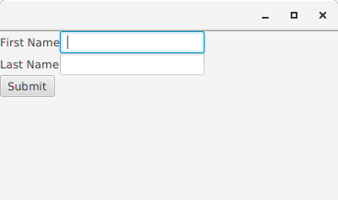
JavaFX GridPane
GridPane Layout pane allows us to add the multiple nodes in multiple rows and columns. It is seen as a flexible grid of rows and columns where nodes can be placed in any cell of the grid. It is represented by javafx.scence.layout.GridPane class. We just need to instantiate this class to implement GridPane.

Slide 19
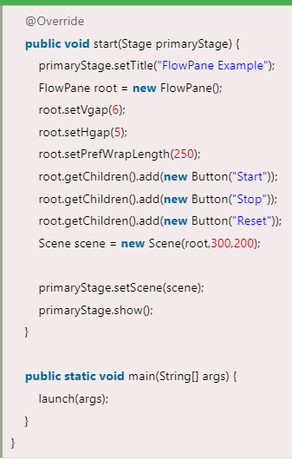
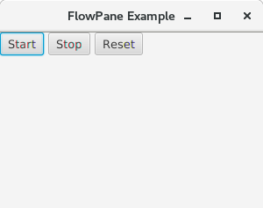
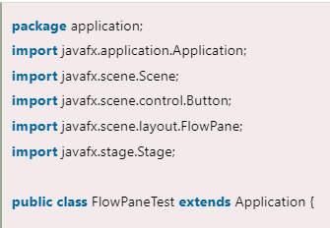
JavaFX FlowPane
FlowPane layout pane organizes the nodes in a flow that are wrapped at the flowpane's boundary. The horizontal flowpane arranges the nodes in a row and wrap them according to the flowpane's width. The vertical flowpane arranges the nodes in a column and wrap them according to the flowpane's height. FlowPane layout is represented by javafx.scene.layout.FlowPane class. We just need to instantiate this class to create the flowpane layout.

Slide 20
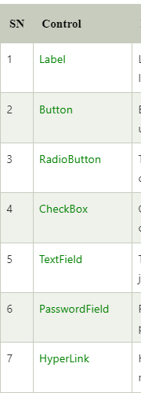
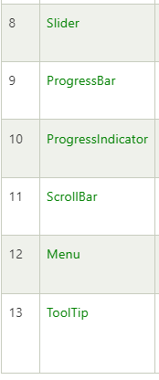
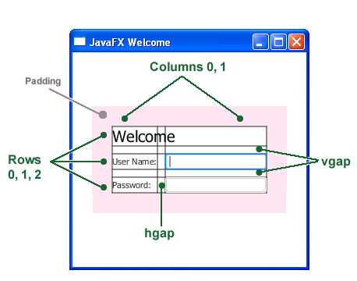
JavaFX UI Controls
Creating a Form in JavaFX

Slide 21
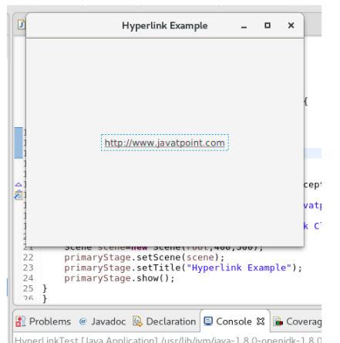
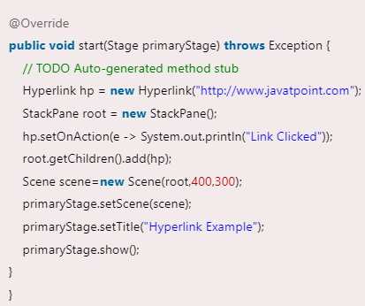
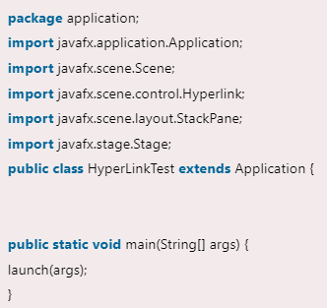
JavaFX HyperLink

Slide 22
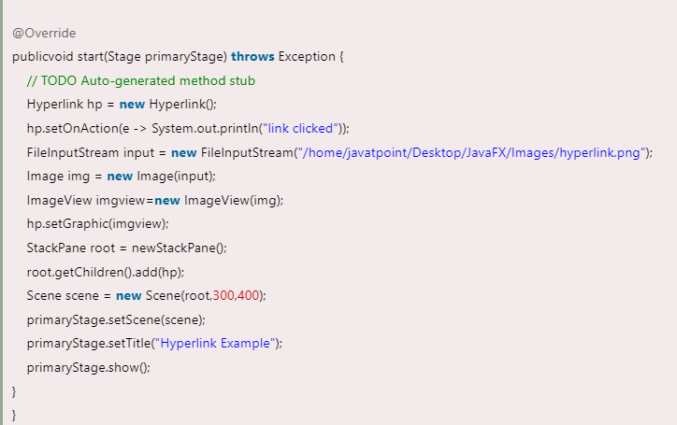


Attaching the image with the link

Slide 23



JavaFX Menu

Slide 24



JavaFX Tooltip
JavaFX Tool tip is used to provide hint to the user about any component. It is mainly used to provide hints about the text fields or password fields being used in the application.

Slide 25



JavaFX FileChooser

Slide 26


Example 2:
The following code shows a Label, TextField and a Button to the user. An open file dialogue box will open on clicking the browse button.

Slide 27



Saving Files : The following code shows the dialogue box for saving the files.

